Slide 1


SSI FRANCHISE
Prevent Injury Prolong Career
Our Vision:
To build public interest in the country’s top sportspersons, whose success would evolve awareness and pride in India.
Our Mission:
Our mission, formulated five years ago which is to optimize the sporting performance and health of all through the execution, dissemination, and application of science.

Slide 2


What we offer ?
100 – 300 state of the art sports medicine & sports rehab centre.
State of art sports medicine care.
Highly educated sports medicine, sports physiotherapist & sports scientists.
Tailor made prehad, rehab and fitness protocols.
Integrated digital content & AI Fitness partner.

Slide 3


Centres
Bhubaneswar – Unit-7, AMRI
Puri
Rourkela
Berhampur
Bhilai
Goa
Hyderabad

Slide 4

Why Partner with SSI
Great ROI
Highly optimized capital investment with high ramp up rate and retention.
SSI Marketing Strength
SSI’s Demand generation capabilities through digital marketing & brand campaigns.
Top qualities sports physiotherapist
Top qualities sports science experts / sports scientists.

Slide 5
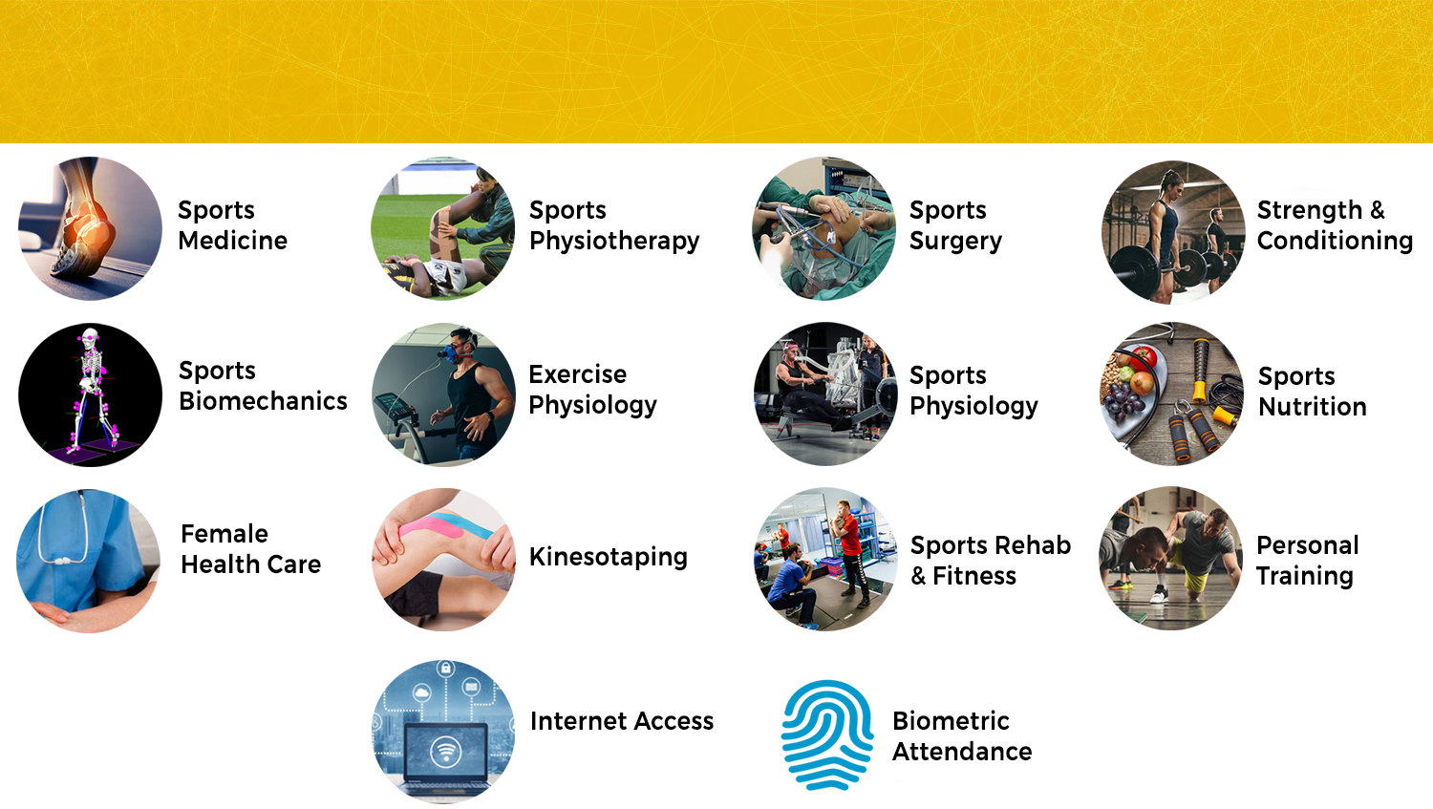
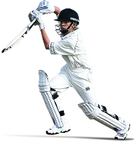
OFFERINGS & FACILITIES

Slide 6

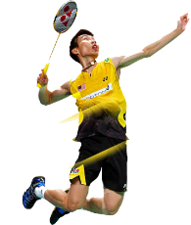
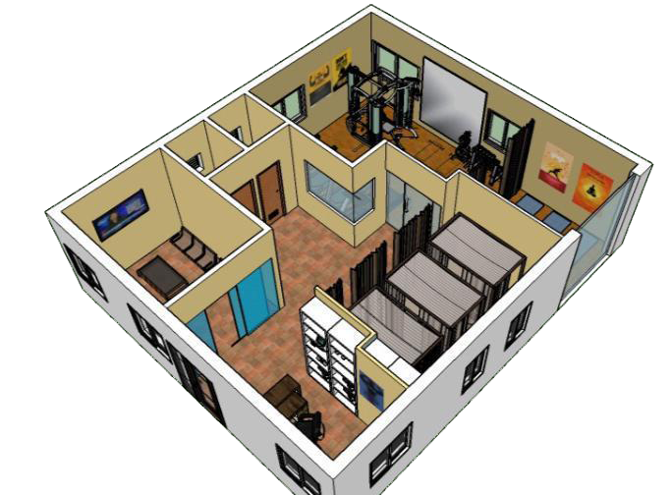
Typical Centre Layout
Reception & Member Lounge
Cardio Area
Sports Medicine & Consultation Area
Rehab & Fitness Area
Physiotherapy Area
Dressing / Treatment Area
Trainer’s Lounge

Slide 7


Franchise Journey
Partner induction
Preliminary Discussion
Partner Discussion
Partner Profile Assessment
Contract Closure &
Partner induction
Partner execution
Site selection & Approval
Layout & Design
Partner Profile Assessment
Contract Closure &
Partner induction
Centre Launch
Preliminary Discussion
Partner Discussion
Partner Profile Assessment
Contract Closure &
Partner induction

Slide 8




Investment & ROI
Investment Amount
| 5-10 L
Area Required
| 4000 sft
Average Payback
| 1 Year
ROI
|

Slide 9
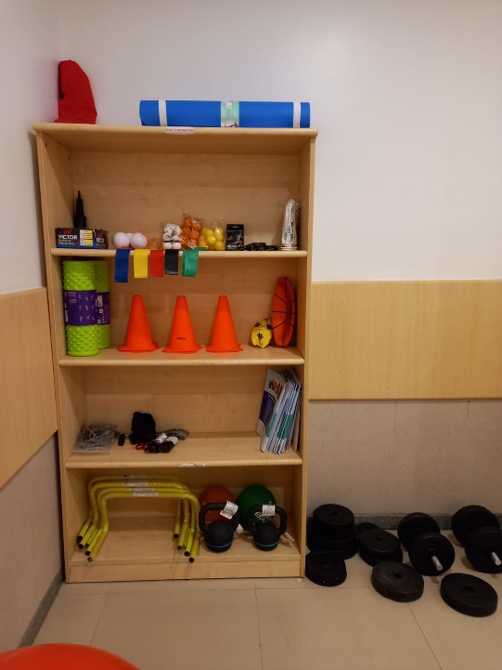
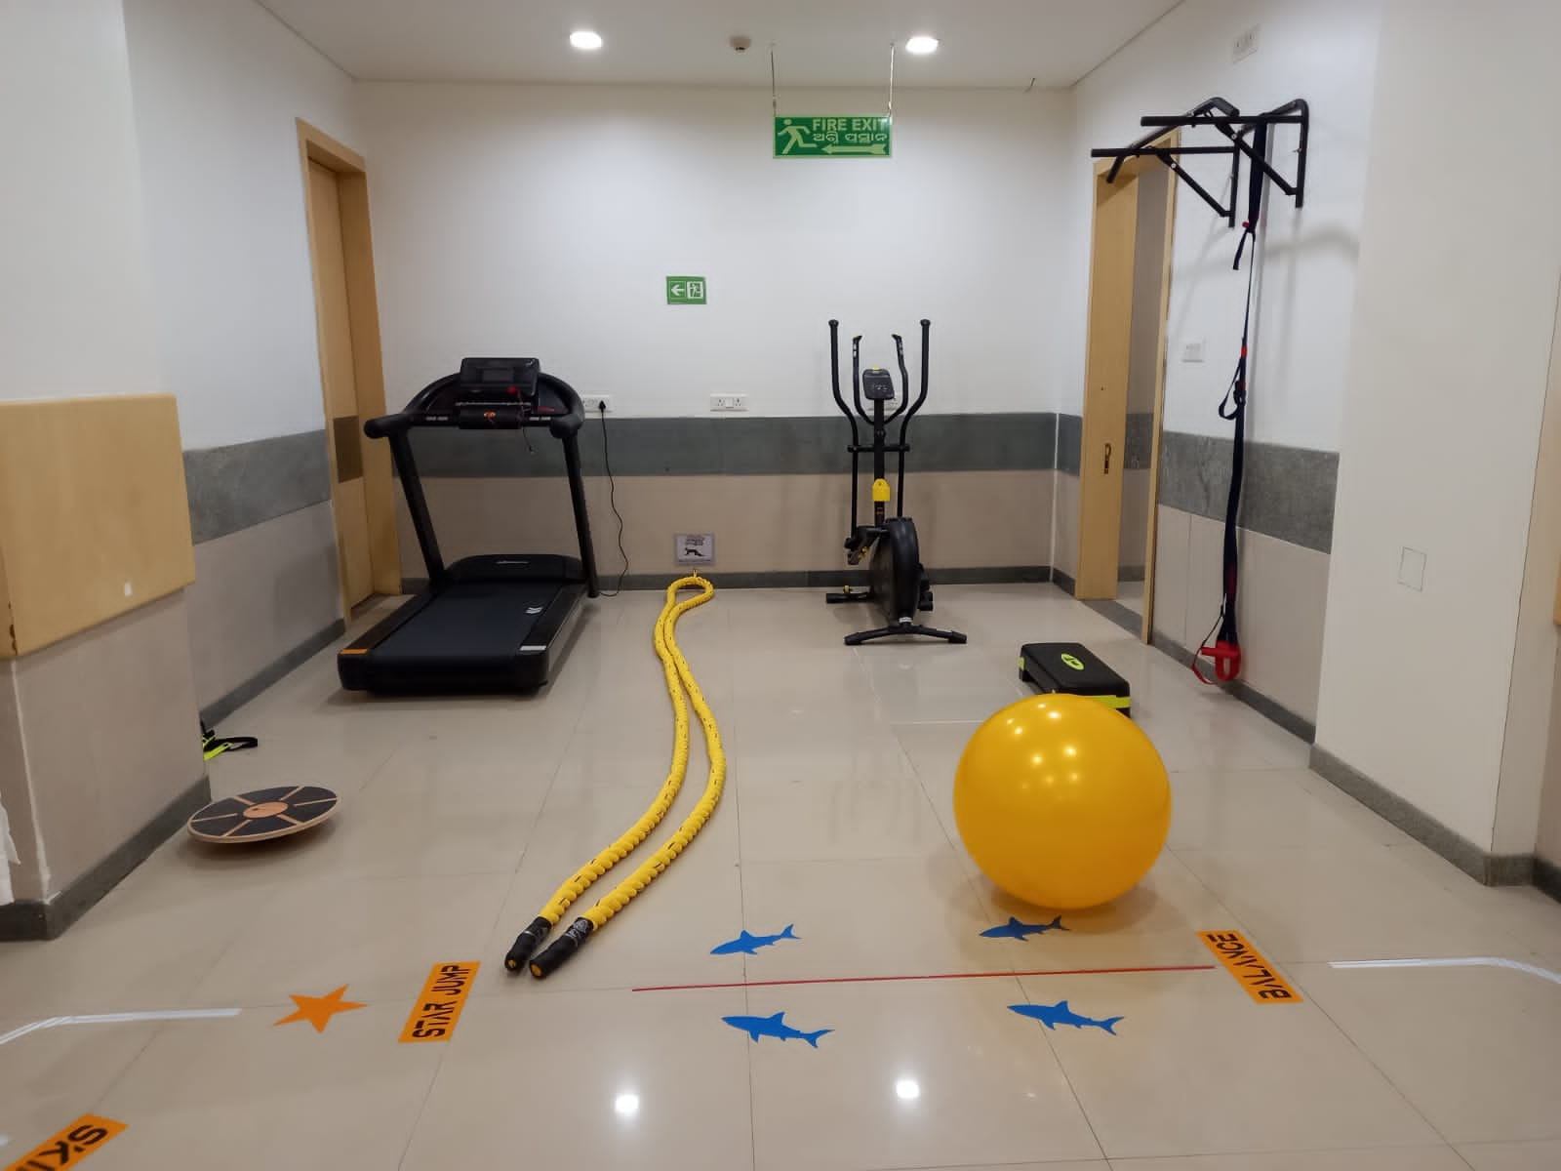
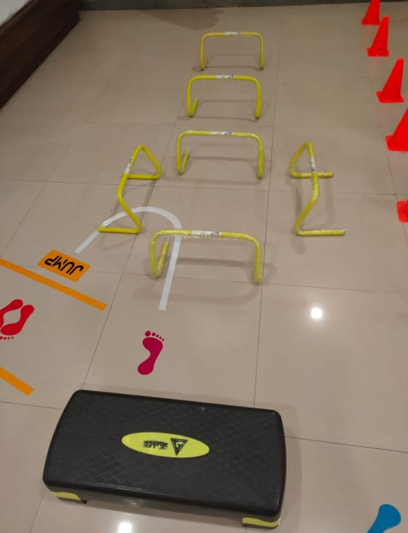
SSI in AMRI
Sports Cardiac Rehab

Slide 10
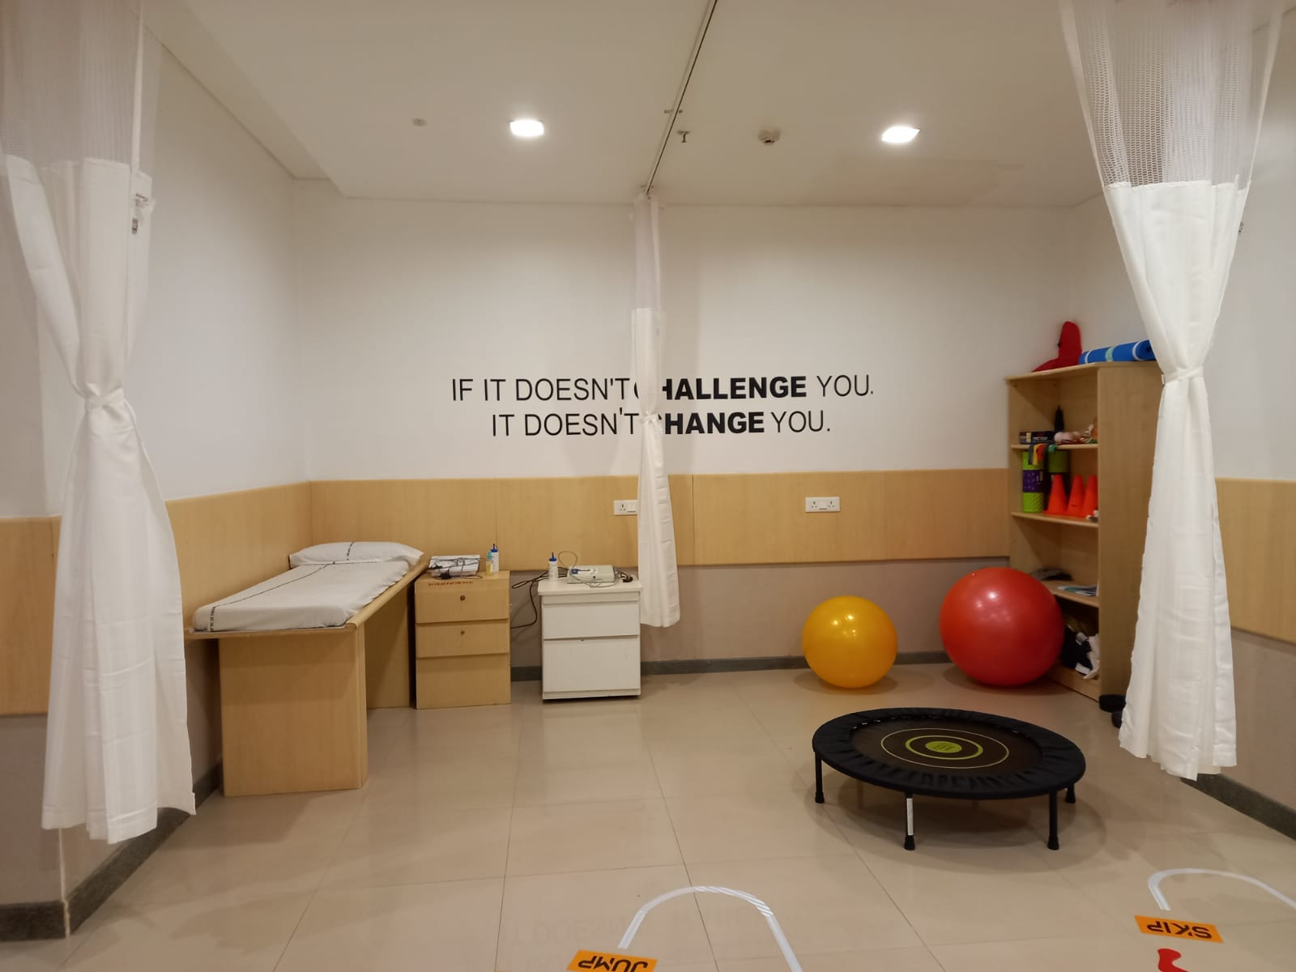
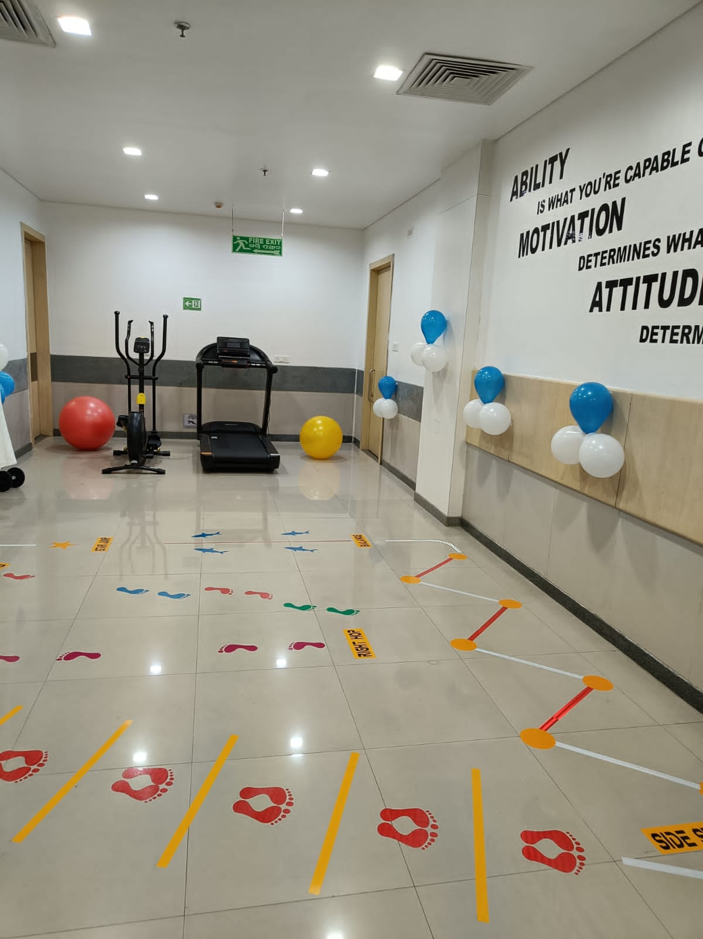
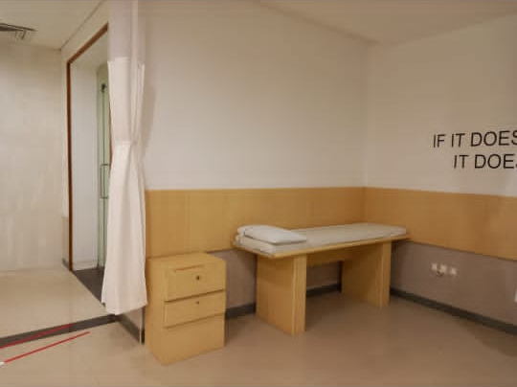
SSI in AMRI
Examination Room
Treatment Room

Slide 11
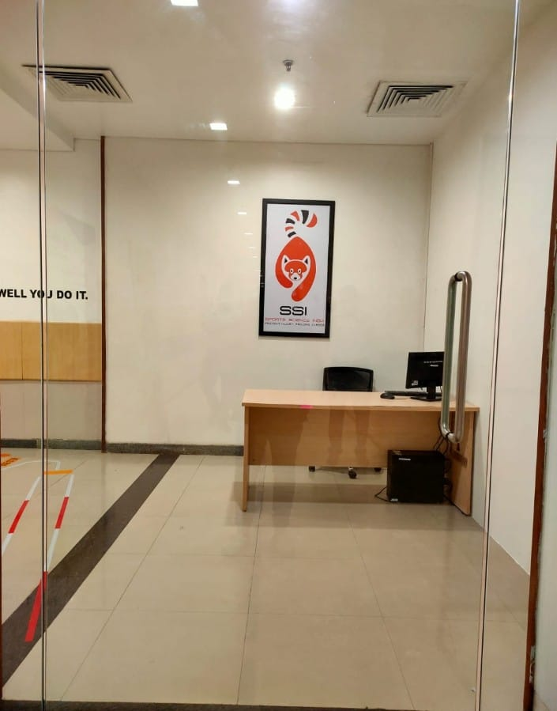
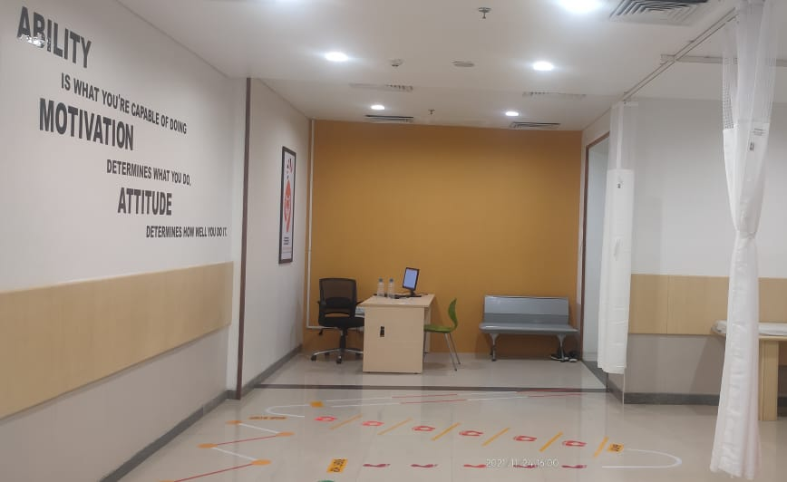
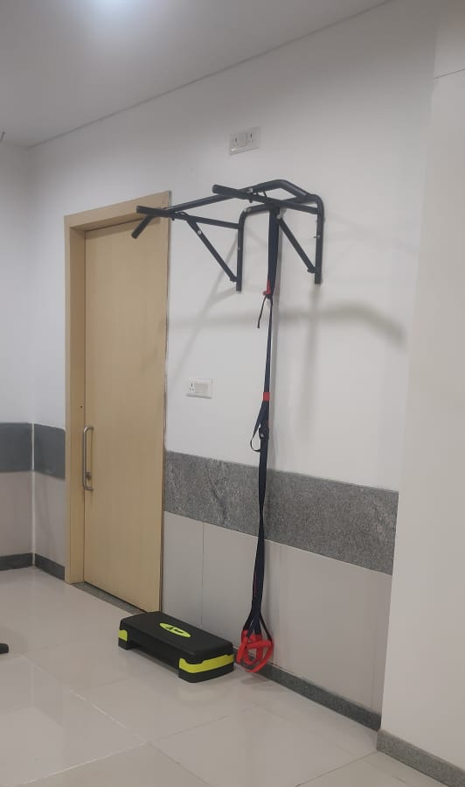
SSI in AMRI
Reception and Waiting Area
TRX

Slide 12

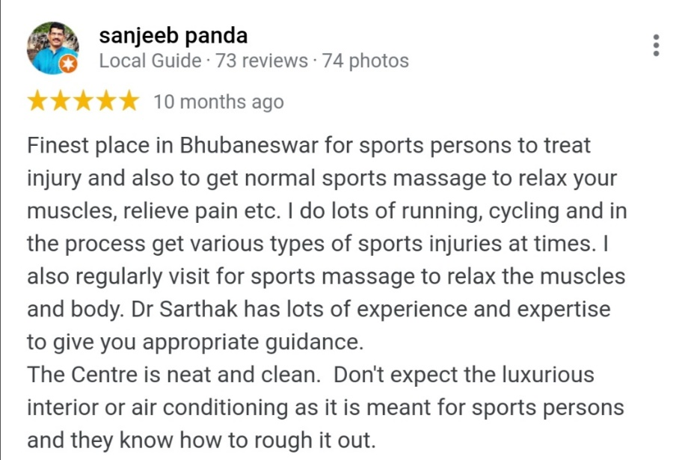
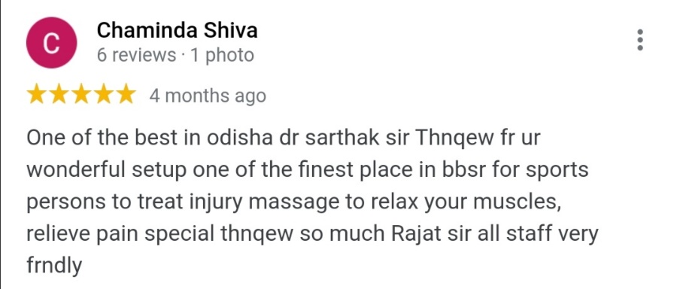
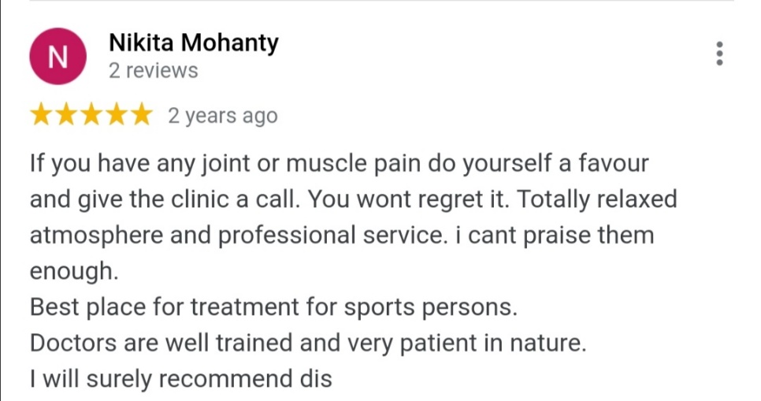
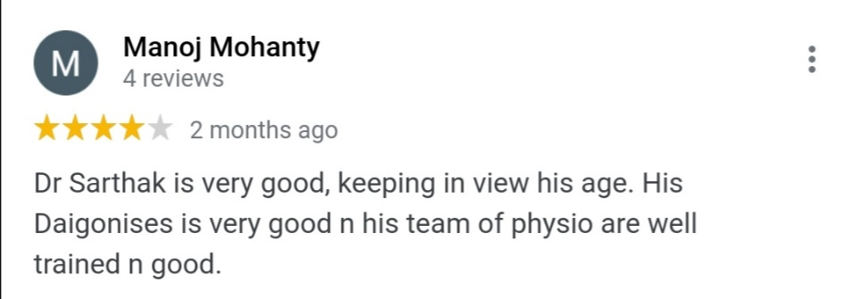
Testimonials

Slide 13
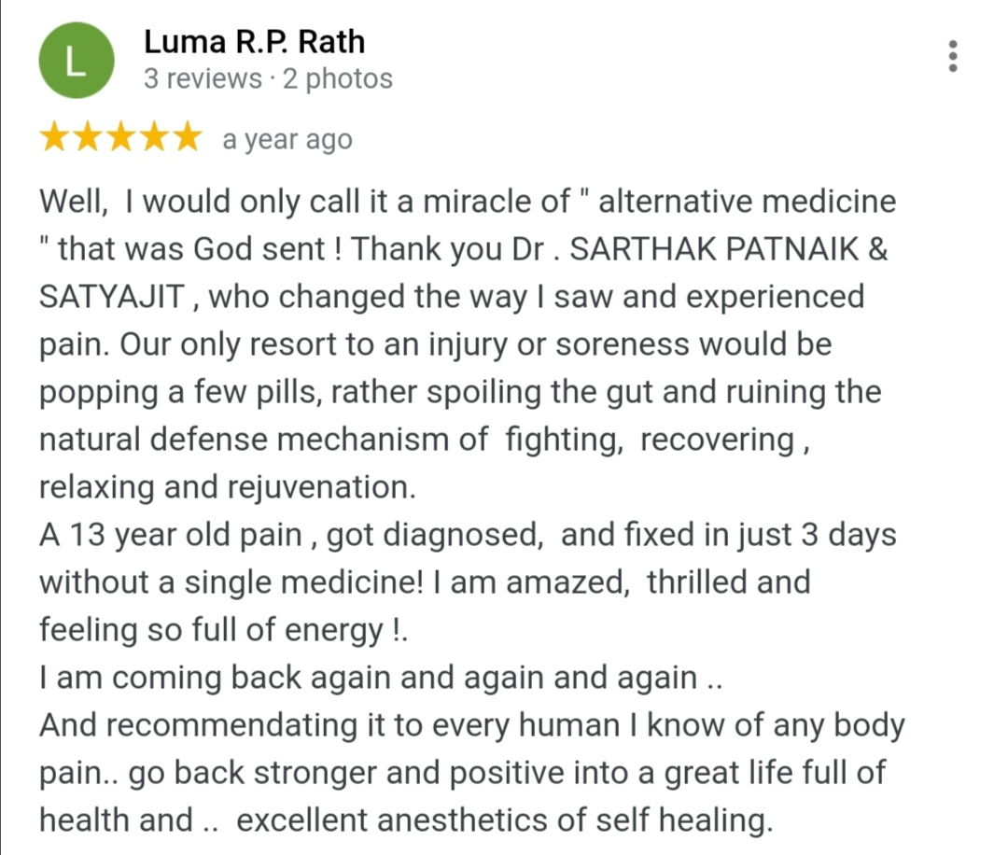
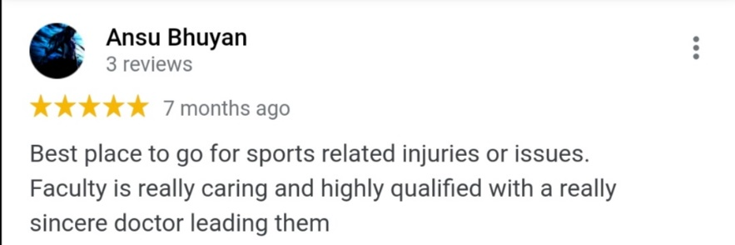
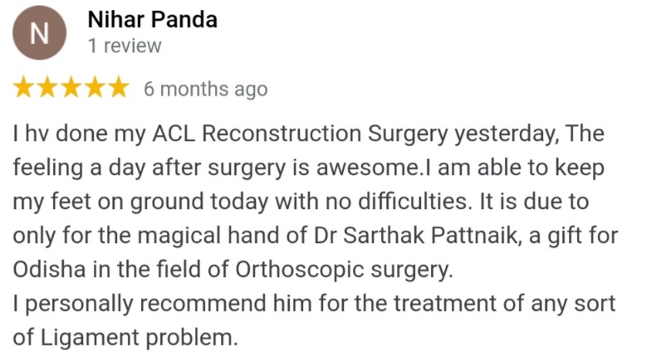
Testimonials

Slide 14
For more details Contact: Sports Science India
Reach us @ +91 – 7381380010
+91 – 8280381010
Write us @ sportscienceindia@gmail.com
Visit us @ A-17/1A, in front of S.P Vigilance office, Unit 7, Surya Nagar, Bhubaneswar, 751003

